Slide 1
Types of Variables in MATLAB

Slide 2
MATLAB provides two basic types of variables:
Local Variables
Global Variables

Slide 3
Local variable
Each MATLAB function has its own local variables.
These are separate from those of other functions and from those of the base workspace.
Variables defined in a function do not remain in memory from one function call to the next.
When called from a function, they share that function's workspace.

Slide 4
Global variables
Each script file variable are global variables.
They store their variables in a workspace that is shared with the caller of the script.
When called from the command line, they share the base workspace.

Slide 5
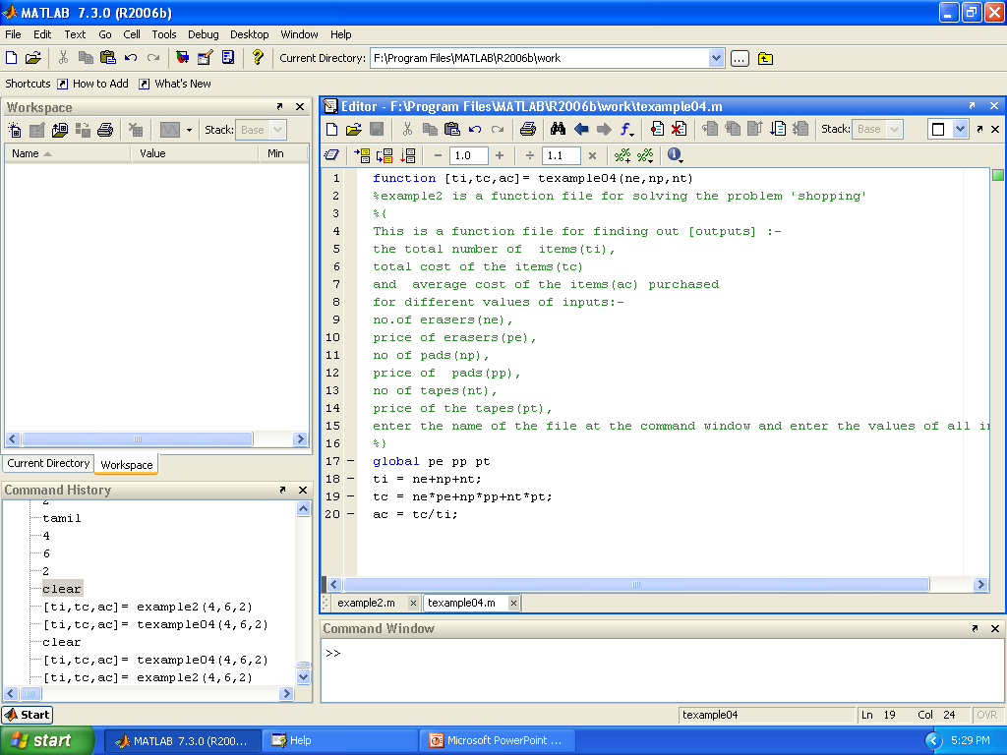
Global Variables in function file
Now workspace is empty
To create the global variable pe,pp,pt
Write function here

Slide 6
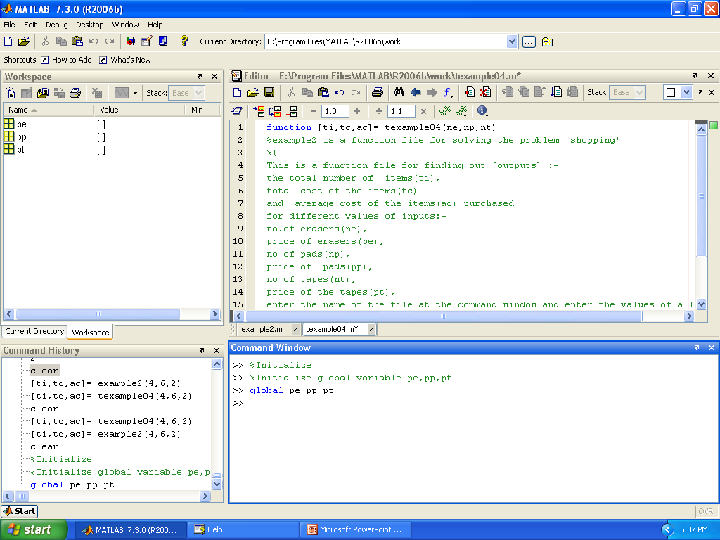
Global Variables in function file (cont)
Global variables are display in workspace but in empty
a
Initialize the global variable

Slide 7
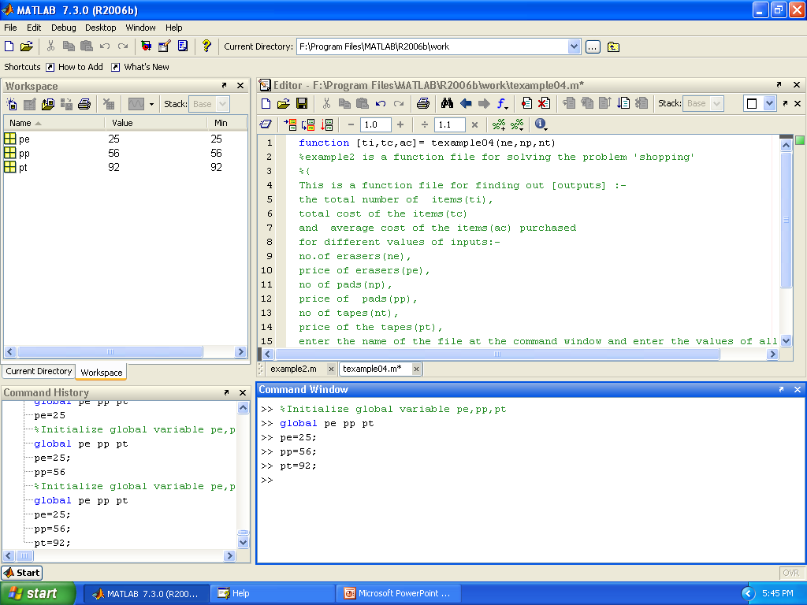
Global Variables in function file (cont)
Now the Global variables are get value
a
Create the global variable

Slide 8
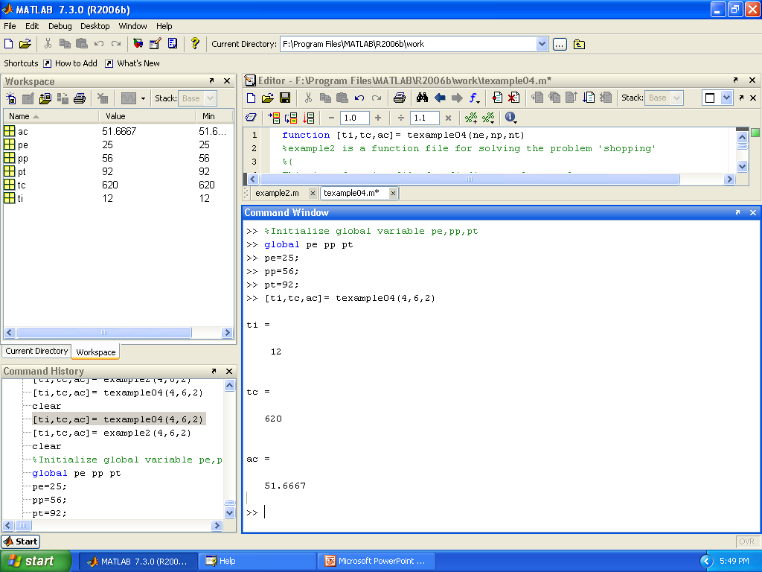
Global Variables in Function file
Now the Global variables are displayed
Execute the function
Get the answer
a

Slide 9
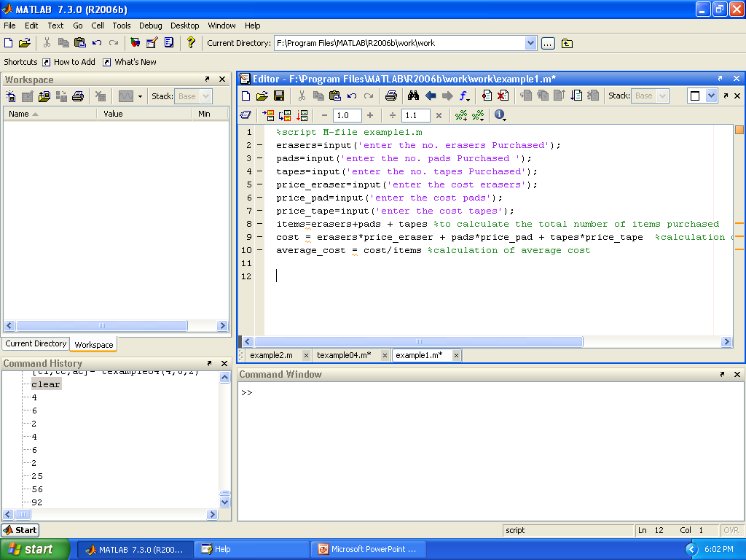
Global Variables in Script file
Click here to run
Now workspace is empty
Write the program here

Slide 10
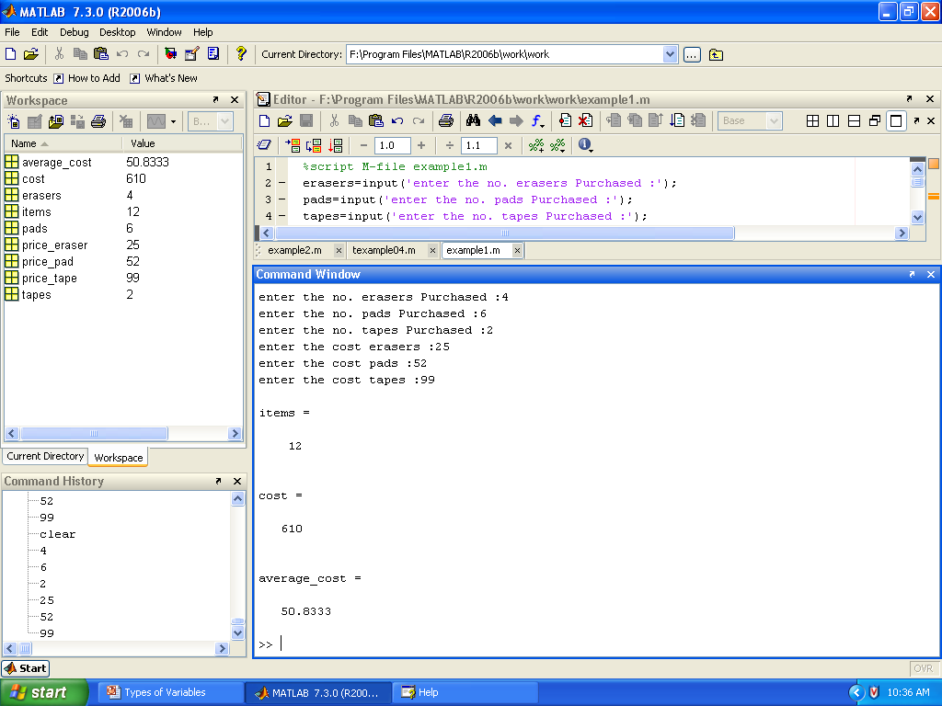
Global Variables in Script file
Enter the value here
Now the Global variable are displayed

Slide 11
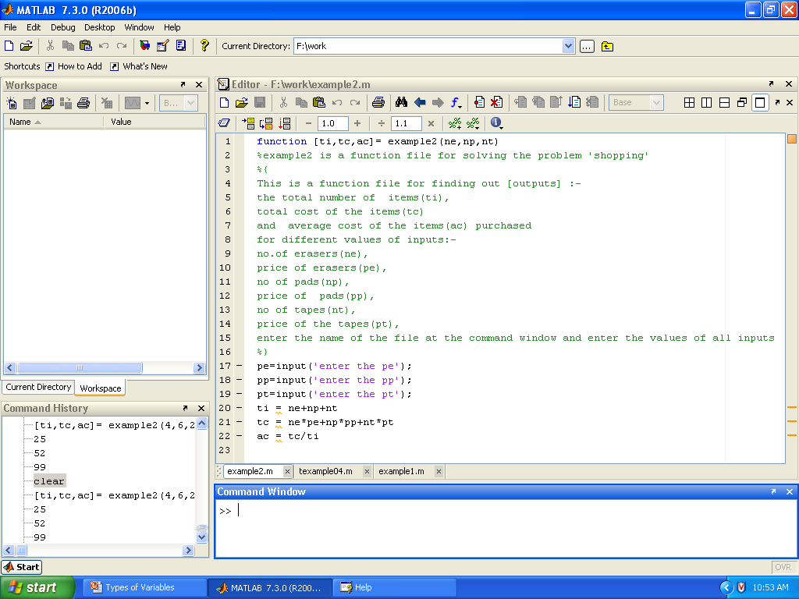
Local Variables in function file
Now workspace is empty
Write the program here

Slide 12
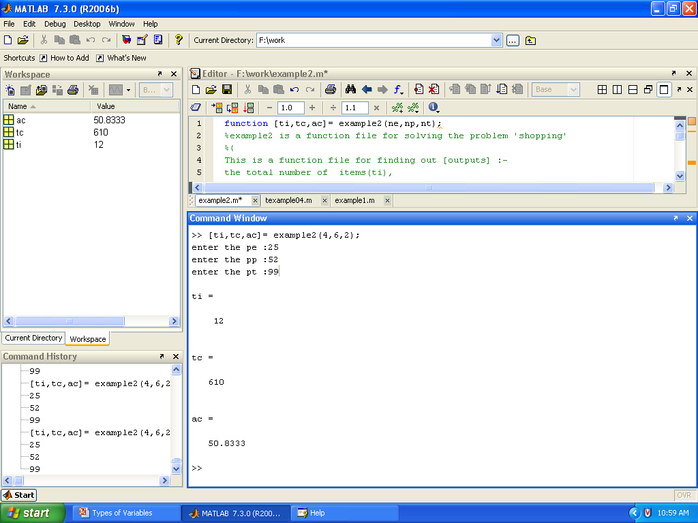
Local Variables in function file (cont)
Only display ‘global variable’ not ‘local variable’
Run the function file here

